Slide 1


Rule Changes Affecting Extra Inning Game Length in the Pioneer Baseball League
Billy Fryer¹
¹ North Carolina State University
Abbreviated abstract: Major League Baseball has been experimenting with rule changes in order to limit game time for games that went to extra innings. This began in 2018 with the implementation of the Runner on Second Rule in the Minor Leagues. After the restructuring of MiLB in 2019, the Pioneer Baseball League rebranded as an independent league and experimented with a “Knockout Round” to replace extra innings with a penalty kicks like homerun derby during the 2021 season. This project uses analysis of variance to quantify whether the new rules have made an impact game time.
UCSAS
2021
billyfryer@att.net - 1

Slide 2
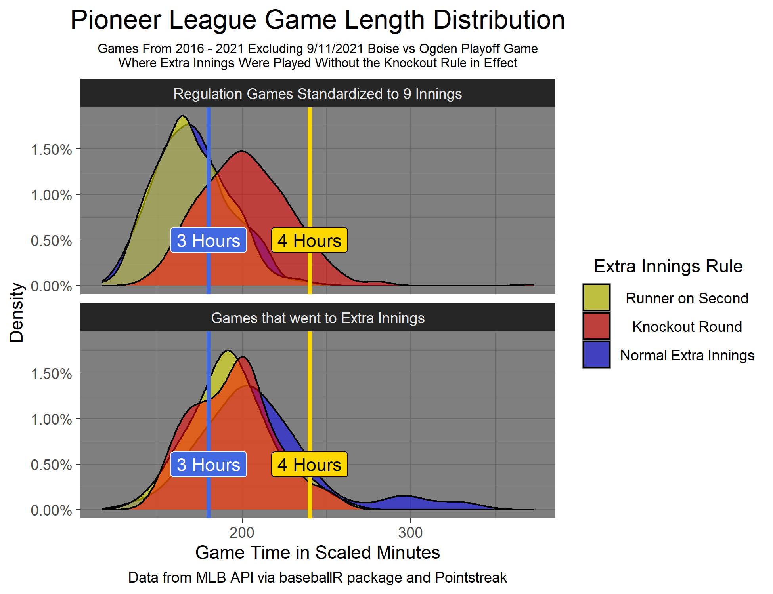
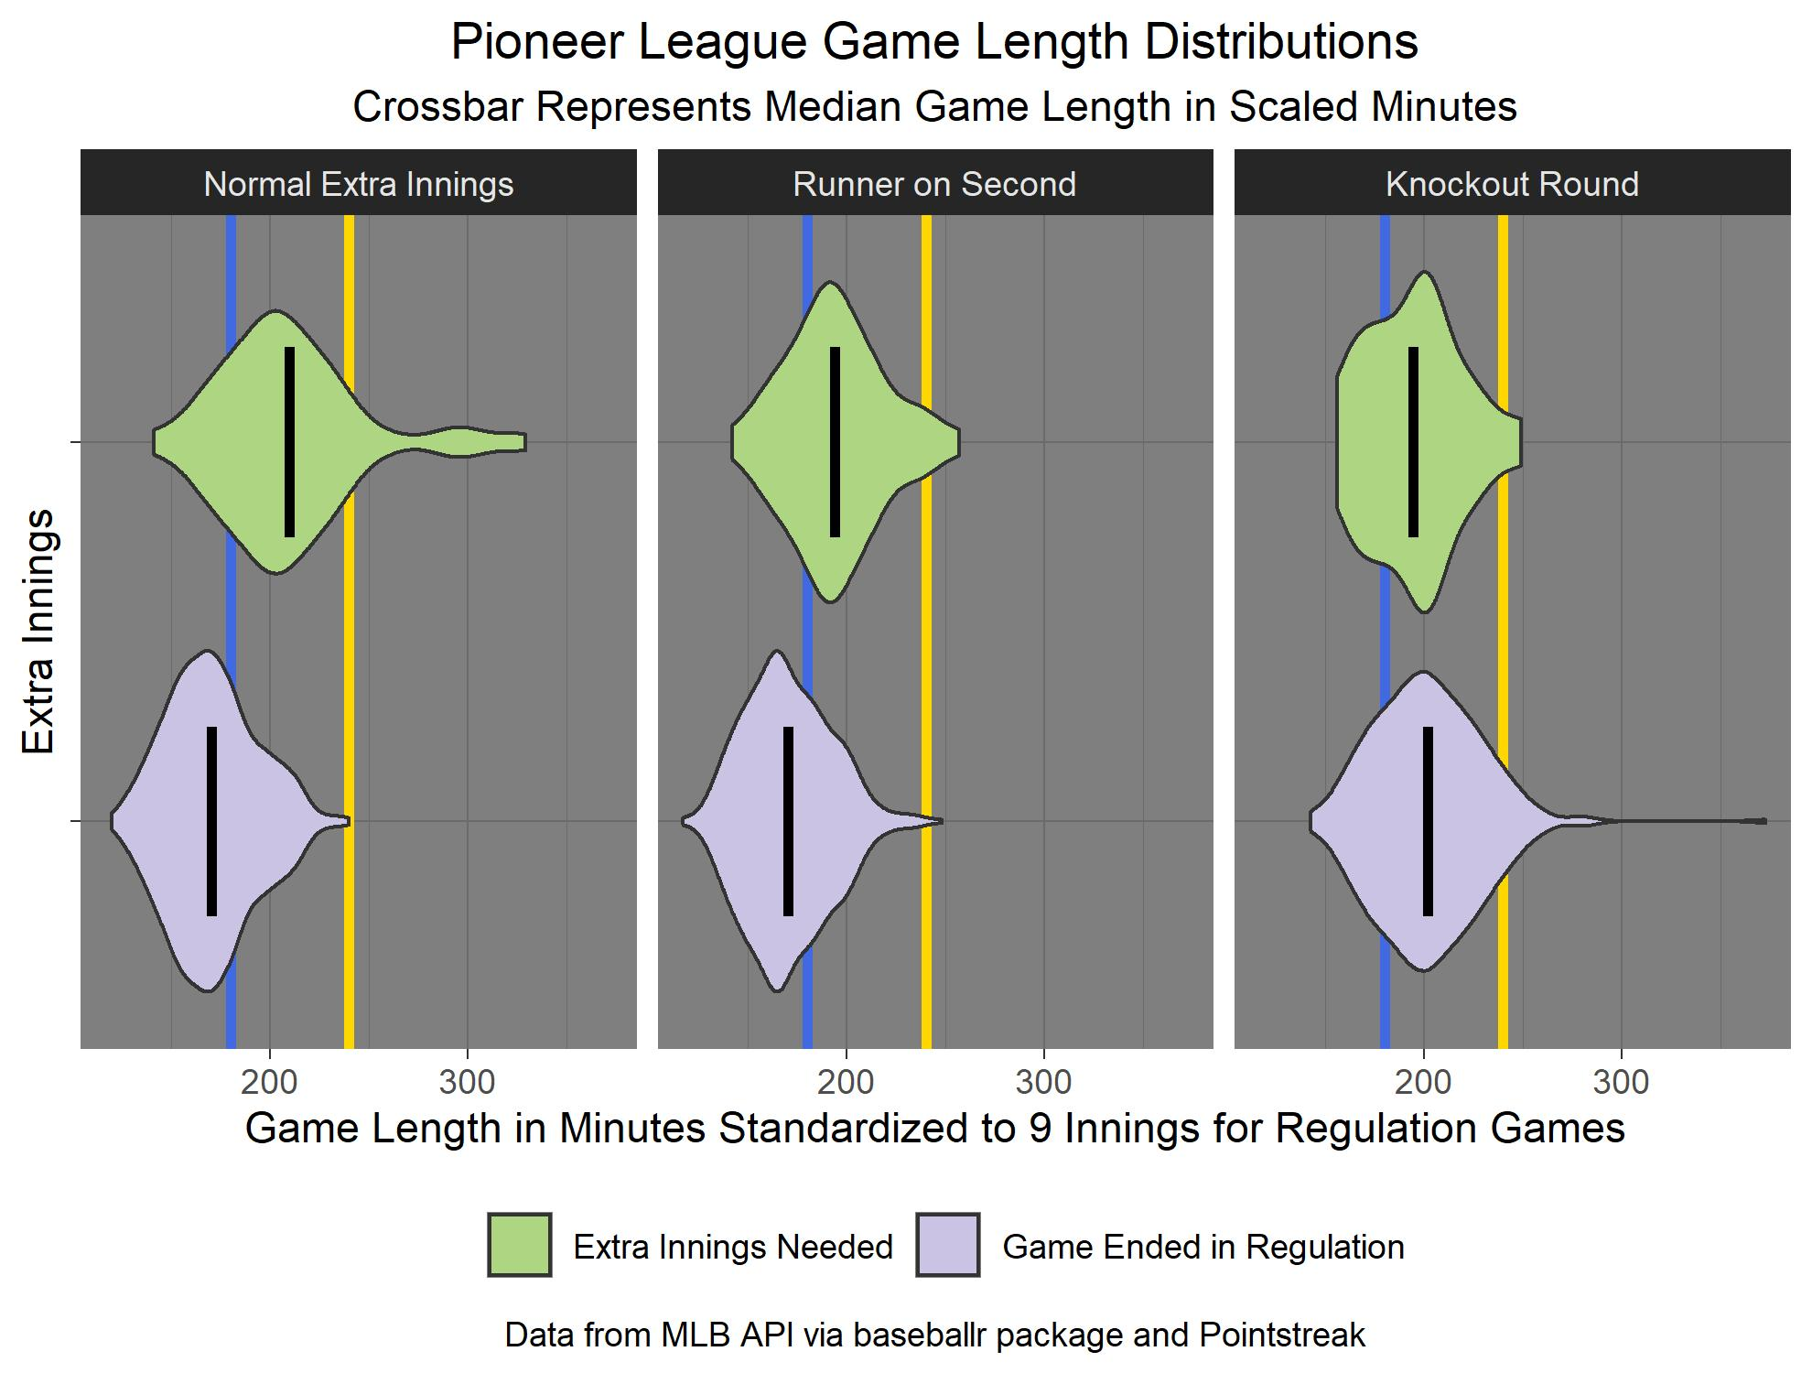
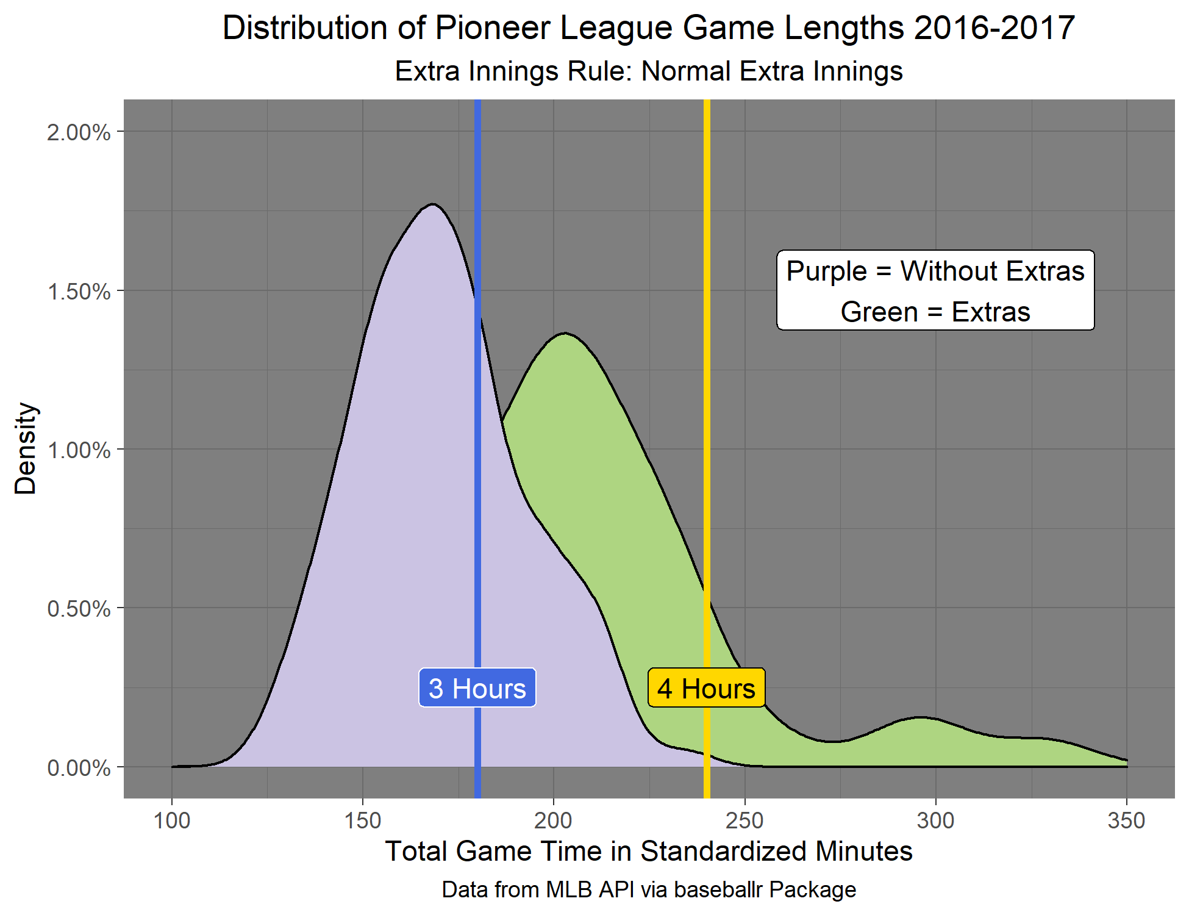
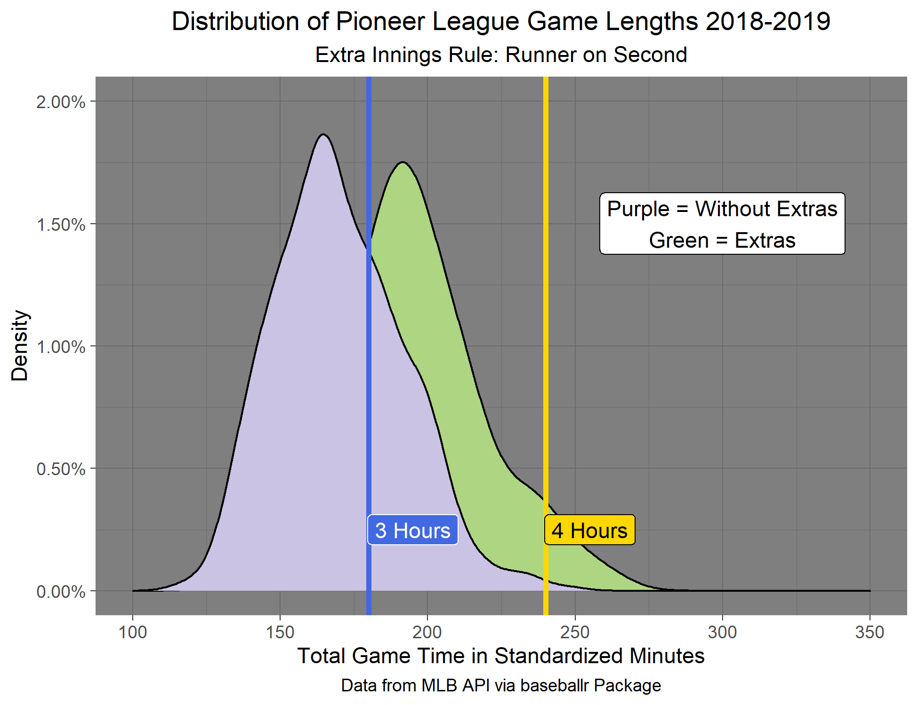
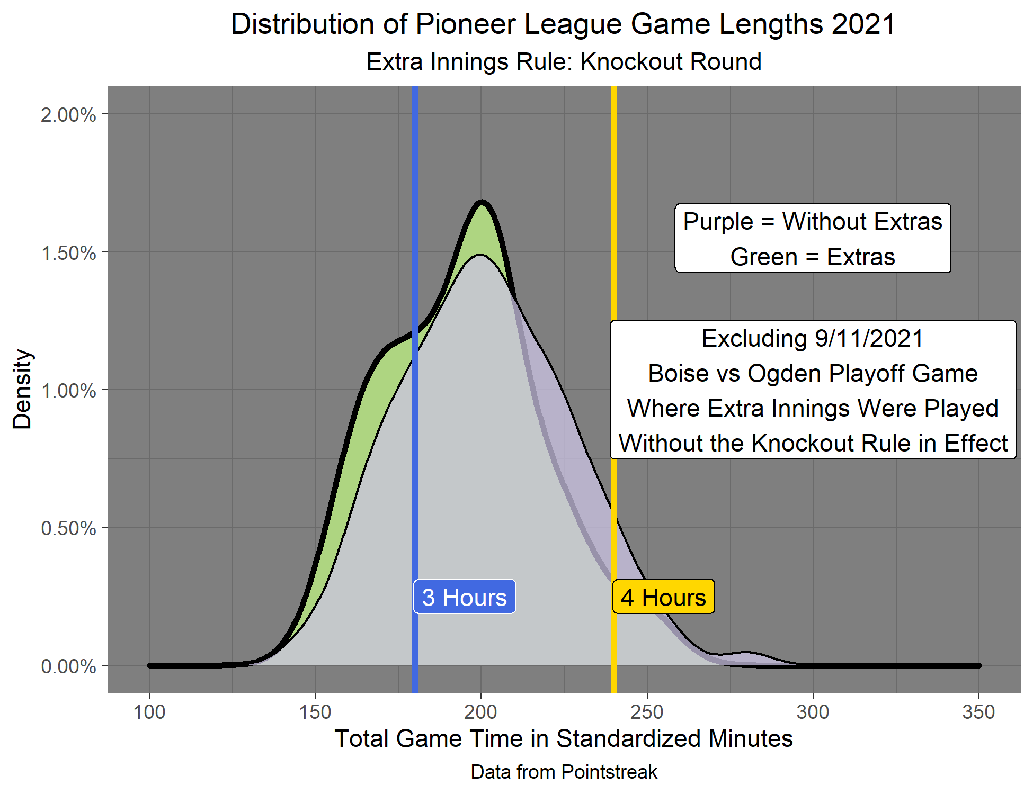
Problem: Baseball games are taking too long, especially those that are going into extra innings.
Solution: Three different extra inning rules have been proposed: Normal Extra Innings, Extra Innings starting with a Runner on Second, and the Knockout Round which functions as a 5-swing homerun derby to determine the winner.
Data: Data is from MLB API for 2016-2019 Seasons. Data is from Pointstreak for 2021 Season.
UCSAS
2021
billyfryer@att.net - 3

Slide 3
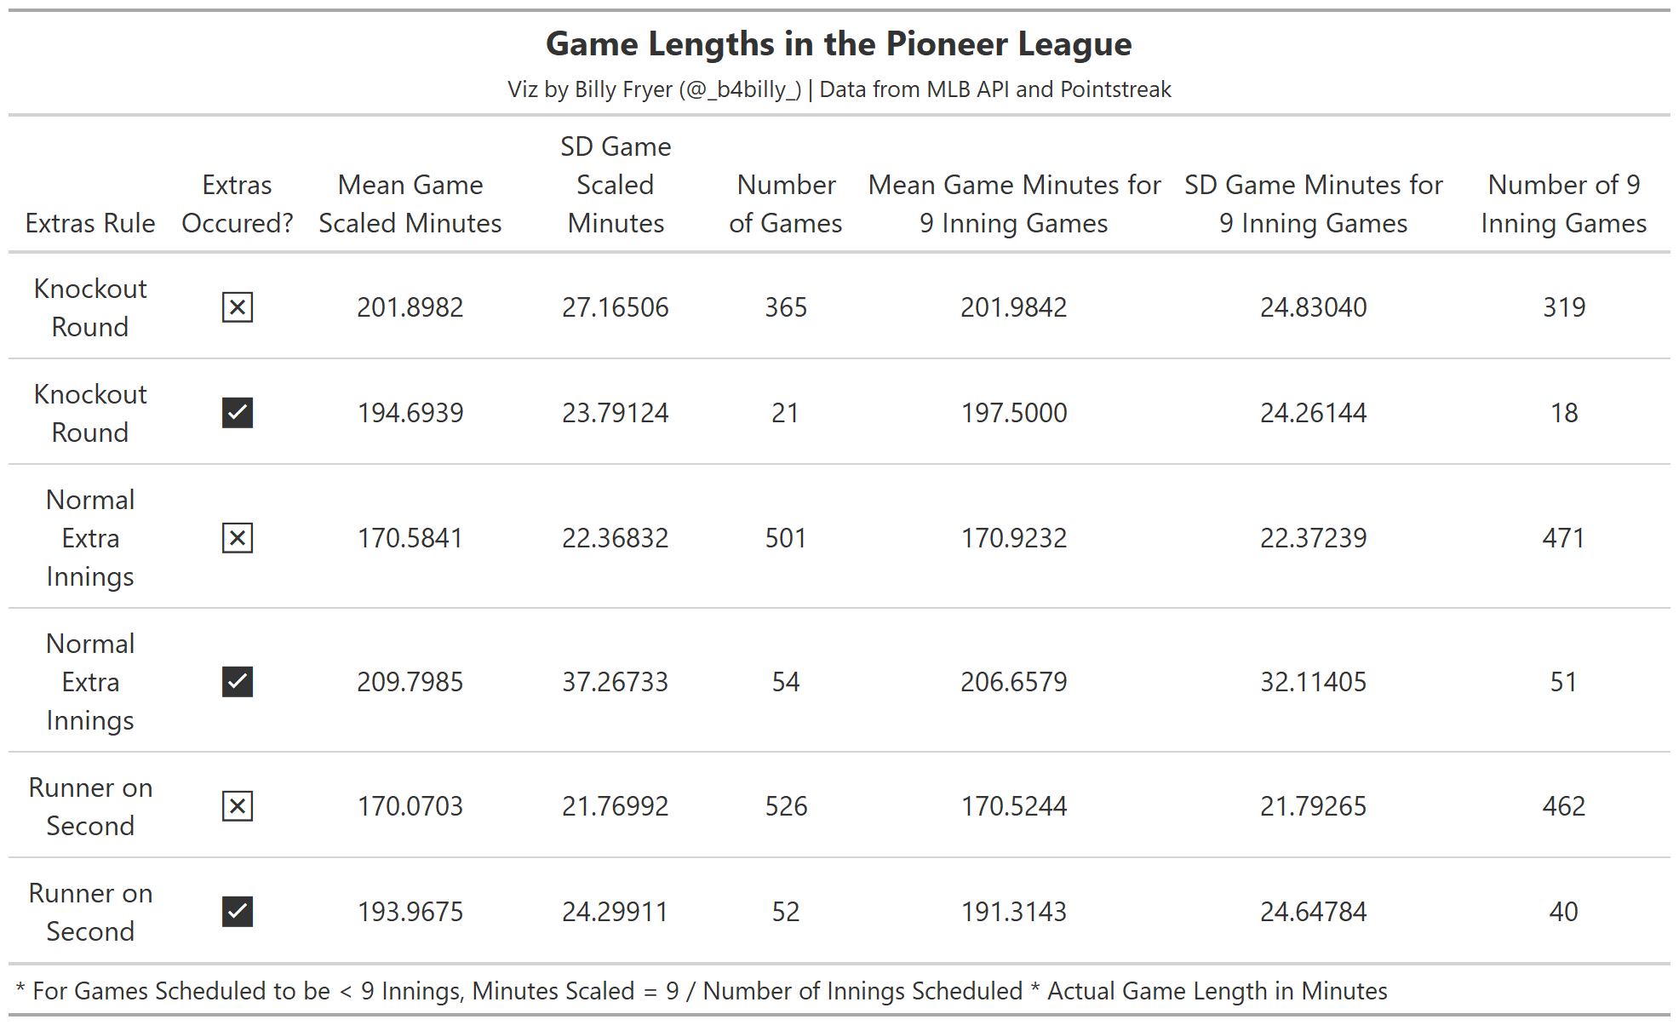
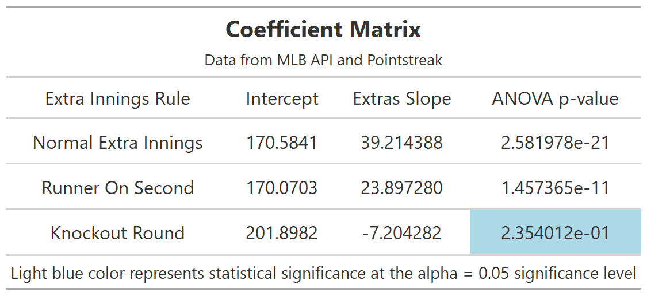
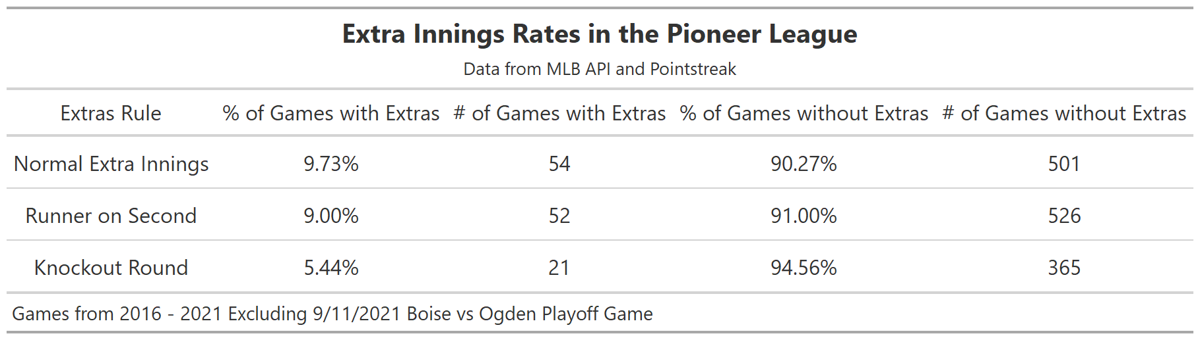
Methodology
Analysis of Variance (ANOVA) was performed to find if there was a statistical significance difference in game time for games that went to extra innings.
For the Normal Extra Innings and Runner On Second Rules, this was the case, but for the Knockout Round the hypothesis that extra innings changed the game length could not be rejected.
UCSAS
2021
billyfryer@att.net - 2

Slide 4
Conclusions
On average, the Knockout Round appears to be the most efficient in reducing the length of games, however due to the small sample size there is not conclusive evidence of this. More games with the Knockout Rule coming into effect need to be played.
The Runner on Second Rule does appear to end games that go to extra innings quicker than playing Normal Extra Innings, meaning that the Runner on Second Rule fulfills its purpose.
UCSAS
2021
billyfryer@att.net - 4

